Slide 1
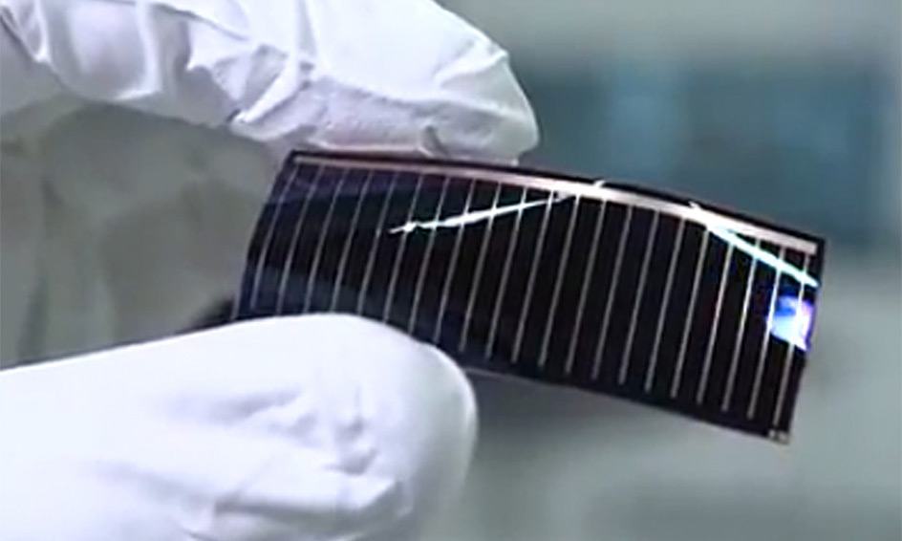
Renewable Energy
Ali Jamali-laleh (215372261) – York University
Introduction:
For many years humans have been utilizing natural resources to engender energy. From years before, humans used wood and fire but later on with the revelation of oil and gas things transmuted drastically. There is no doubt that Oil and gas have been our primary source of energy since then. However, it hasn’t been without it’s downsides. Oil and gas are non-renewable sources of energy which denotes in future Oil and gas will run out. Not only that but burning oil and gas causes pollution which then causes health problems such as lung cancer. The pollution caused by burning oil and gas isn’t only toxic to mankind but it’s toxic to all living engenders on earth and is additionally toxic to our environment. It is very paramount we find a source of energy to supersede with oil and gas. As it turns out we have recently been able to make solar panels to observe energy from the sun and store it to use it in a form of electricity. With solar panels or other type of renewable energy, we will no longer damage our environment and all the other living things by burning oil and gas. One other astronomically immense benefit of renewable energy is to obviate the formation of greenhouse gases.
Objective:
Our goal as a company is to:
Replace insalubrious non-renewable energy with clean and more potent renewable energy
Informe more people and engineers about the crucial benefits of renewable energy for a better future!
With help of our brightest engineers, increase efficiency of renewable energy for a better technological future.
According to the US department of Energy’s National, Solar technology has been ameliorated dramatically to 41% efficiency. With the utilization of an incipient material called gallium arsenide there is a potential for an incrementation of 50% efficiency. It is withal possible to even reach 80% efficiency in future if enough attention is put towards this technology.
Even the cost of this incipient material will be low, lower than 1$ per watt ( this is the price for solar panels composed of Silicon).
Our solutions:
An incrementation in solar panel efficiency can be done by transmuting material used. This material exchange will be between crystallized silicon and our own choice of use which is gallium arsenide. Better efficiency is ensured and more frugal cost of production and maintenance is also a plus.
Figure:
https://www.altadevices.com/technology/.
References:
DOE (U.S. Department of Energy). 2007. Solar America Initiative: A Plan for the Integrated Research, Development, and Market Transformation of Solar EnergBeard, M.C., et al. 2007. Multiple Exciton Generation in Colloidal Silicon Nanocrystals. Nano Letters 7(8): 2506-2512. DOI: 10.1021/nl071486l S1530-6984(07)01486-5
DOE. Solar Energy Technologies Program Multi-Year Program Plan 2007-2011. Office of Energy Efficiency and Renewable Energy. Washington, D.C.: DOE.
Lewis, N.S. 2007. Toward Cost-Effective Solar Energy Use. Science 315(5813): 798-801. DOI: 10.1126/science.1137014
DOE (U.S. Department of Energy). 2007. Solar America Initiative: A Plan for the Integrated Research, Development, and Market Transformation of Solar Energy Technologies. Report Number SETP-2006-0010. Office of Energy Efficiency and Renewable Energy Solar Energy Technologies Program. Washington, D.C.: DOE.
Schaller, R.D., and V.I. Klimov. 2004. High Efficiency Carrier Multiplication in PbSe Nanocrystals: Implications for Solar Energy Conversion. Physical Review Letters 92(18): 186601-1 - 186601-4. DOI: 10.1103/PhysRevLett.92.186601
-Beard, M.C., et al. 2007. Multiple Exciton Generation in Colloidal Silicon Nanocrystals. Nano Letters 7(8): 2506-2512. DOI: 10.1021/nl071486l S1530-6984(07)01486-5

